Slide 1
Machine Learning
Machine Learning Introduction to Machine Learning by Kumar Anurupam is licensed under a Creative Commons Attribution-4.0 International License.
Decision Tree Classification – Overfitting and Underfitting
CS 3104 Fall 2019
Lecture Slides by Kumar Anurupam

Slide 2
Learning Objectives
After completion of today’s session you will be able to:
Explain the problem of overfitting and underfitting in decision trees.
Explore various approaches to overcome the overfitting problem.

Slide 3
Problem of underfitting and overfitting
The errors committed by the classification method is divided into two types:
Training error/Substitution error/apparent error: These are the misclassification errors committed on the training records.
Generalization error: It is the expected error of the model on previously unseen records.
A good model must have low training error as well as low generalization error.
A model that fits a training data too well can have a poorer generalization error than a model with high training error. Such a situation is known as overfitting.

Slide 4
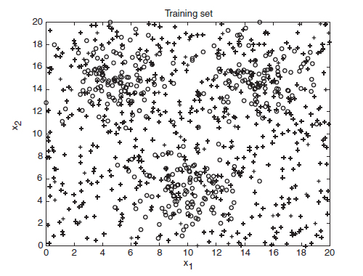
Example
Class o - 1200 points
Class + - 1800 points
Training – 30%
Testing – 70%

Slide 5
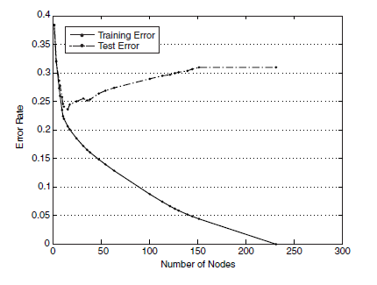
Example – contdd…
Tree is constructed using Gini index and pruned used various approaches to analyze overfitting.
It is analyzed that the training and testing error rates are high when tree is small. This is known as underfitting.
When tree starts growing then both the errors starts reducing.
Once the tree becomes too large, its test error rate begins to increase even though its training error rate continues to decrease. This is known as overfitting.

Slide 6
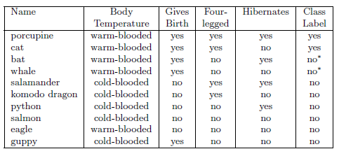
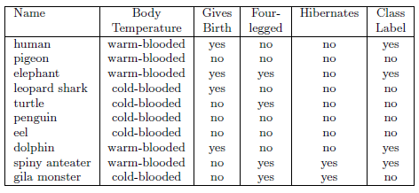
Overfitting due to noise
Training set data
Testing set data

Slide 7
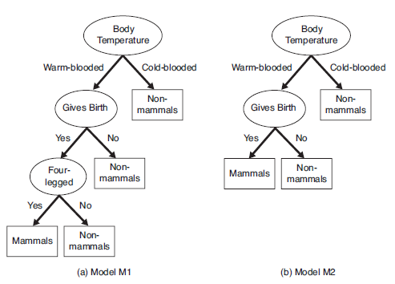
Overfitting due to noise
The decision tree is misclassifying human and dolphins because of the noise present in the training data.
Spiny anteaters is also contradicting the outcome from training and testing data.
Here, model M2 is having lower error rate but little high training error while model M1 is overfitting the data.
Decision induced from the table given before

Slide 8
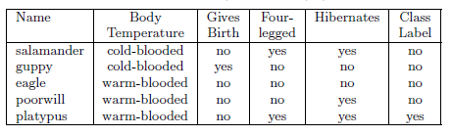
Overfitting due to lack of representative samples
Any classification decision taken on small number of training records are also prone to overfitting.
Training set data
Testing set data

Slide 9
Estimating Generalization Errors
Using re-substitution estimate:
Optimistic approach: e’(t) = e(t)
It is assumed that training set is a good representation of the overall data.
In this the decision tree algorithm selects the model with lowest training set error as its final model.
But training error is the poor estimate of generalization error. So another method is required.

Slide 10

Estimating Generalization Errors
Incorporating model complexity:
When the model becomes complex then the chance of overfitting increases.
So, we must use simpler model which agrees to a well known strategy “Occam’s razor” or “Principle of Parsimony”.
Occam’s razor says that “Given two models of similar generalization errors, one should prefer the simpler model over the more complex model”. In order to accomplish this we use the following approach:
Pessimistic approach:
It is calculated as
Where:
n(t) = Number of training records classified by node t
e(t) = Number of misclassified records
k = Number of leaf nodes
e(T) = Overall training error of the tree
Ω(T) = Penalty for each leaf node
N_{t} = Number of training records

Slide 11
How to overcome overfitting?
Two approaches are used for this:
Pre-pruning
Post-pruning

Slide 12
Stopping Criteria/Rule – Pre-Pruning
Stopping Rule is applied when building a decision tree to prevent the model from becoming overly complex.
The construction of the trees are stopped, if any of the following given criteria(Pre-pruning) is met:
All instances in the corresponding subset are of the same class
The number of instances in the corresponding subset is less than a specified minimum
The level of the current node is greater than a specified maximum, where the level of the root node is 1, and the level of its descendant nodes is 2, and so on.
The improvement of class impurity according to the best available split is less than a specified minimum.
Stop if class distribution of instances are independent of the available features (e.g., using χ2 test)
Stop if expanding the current node does not improve impurity measures (e.g., Gini or information gain).

Slide 13
Post-Pruning
Grow decision tree to its entirety.
Trim the nodes of the decision tree in a bottom-up fashion.
If generalization error improves after trimming, replace sub-tree by a leaf node.
Class label of leaf node is determined from majority class of instances in the sub-tree

Slide 14
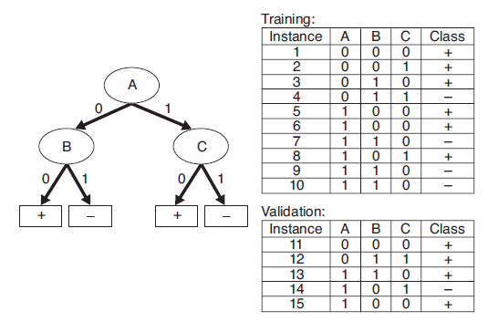
Example
Calculate the generalization error rate of the tree using:
1. Optimistic Approach
Ans. 5/10 = 0.5
2. Pessimistic Approach (Penalty = 0.5)
Ans. (5 + 4 x 0.5)/10 = 0.7

Slide 15
Comparison of Decision Tree Algorithms

Slide 16
Imputation
Imputation is the process of replacing missing data with substituted values.
There are two basic ways to perform imputation:
Single Imputation
Multiple Imputation
Single Imputation:
Deletion: Delete the records having missing value.
Hot Deck: A missing value is imputed from a randomly selected similar record.
Cold Deck: Selects values from another dataset.
Mean Substitution: Replacing any missing value with the mean of that variable for all other cases.
Regression: A regression model is estimated to predict observed values of a variable based on other variables, and that model is then used to impute values in cases where the value of that variable is missing.
Last observation carried forward: Involves sorting a dataset according to any of a variables, thus creating an ordered dataset. the first missing value is replaced by the cell value immediately prior to it.

Slide 17
Imputation – contd…
Multiple Imputation: In order to deal with the problem of increased noise due to imputation, Rubin (1987) developed a method for averaging the outcomes across multiple imputed data sets to account for this.
All multiple imputation methods follow three steps.
Imputation – Similar to single imputation, missing values are imputed. However, the imputed values are drawn m times from a distribution rather than just once. At the end of this step, there should be m completed datasets.
Analysis – Each of the m datasets is analyzed. At the end of this step there should be m analyses.
Pooling – The m results are consolidated into one result by calculating the mean, variance, and confidence interval of the variable of concern.

Slide 18
Instability
The instability problem of decision tree classification algorithms is that small changes in input training samples may cause dramatically large changes in output classification rules.
Decision trees can potentially be unstable if there is a small variation in the data that may result in a completely different tree being generated.
We can combat this by using a variety of ensemble methods such as bagging, boosting etc.

Slide 19
References
[1] Tan, ©., & Steinbach (2004). Data Mining Classification : Basic Concepts , Decision Trees , and Model Evaluation.
[2] https://en.wikipedia.org/wiki/Imputation_(statistics)

Slide 20
Thanks

